Slide 1


EVIDENCE.COM

Slide 2
Contents
Slide Content
3 What is Evidence.com?
4-8 How to create and register an account.
9-12 How to stream BWV footage.
13-15 How to view BWV footage using the CCDCS.

Slide 3
What is Evidence.com?
Police-owned web-based system that provides access to multimedia evidence.
Links to individual items of footage are embedded into documents we serve.
Evidential footage will be uploaded to CCDCS on a new MG0 MME document; disclosable unused footage served by secure email in a new UM BWV document.
Evidence.com only accessible via individual links, not by accessing the website directly.
Users register on Evidence.com when they receive a link to footage for the first time.
Post-registration, access is by entry of user name (secure email address) and password (changed every 90 days) each time you want to access a link.
Footage can be streamed on all devices; downloading is not possible on iPads or iPhones due to Apple iOS restrictions.
Rollout has been completed across the majority of London boroughs, with full rollout by the end of August. Implementation is being prepared with several other police forces including Greater Manchester, West Midlands and British Transport Police.

Slide 4
How to create and register an account
Begin the registration process by clicking the link to the footage. Enter your CJSM email address in the ‘Find my Agency’ field and click Search.

Slide 5
Click on ‘External Advocates.’
As you have not previously registered, click on ‘Register,’ and then enter your CJSM email address: -

Slide 6
Enter the required information in to the fields marked with an asterisk *. Your username needs to be your secure email address in order to give you access. Also click to agree the EULA, and then submit: -

Slide 7
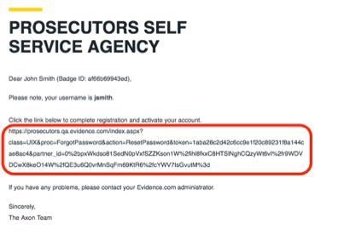
Evidence.com will send an email containing a link to the secure email address you have entered. Click that link or copy and paste in to a browser:

Slide 8
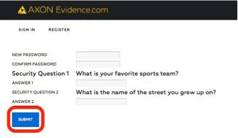
Create a new password and answer the security questions (the only time you will need to do this) and click submit: -
Your account is now registered and active.

Slide 9
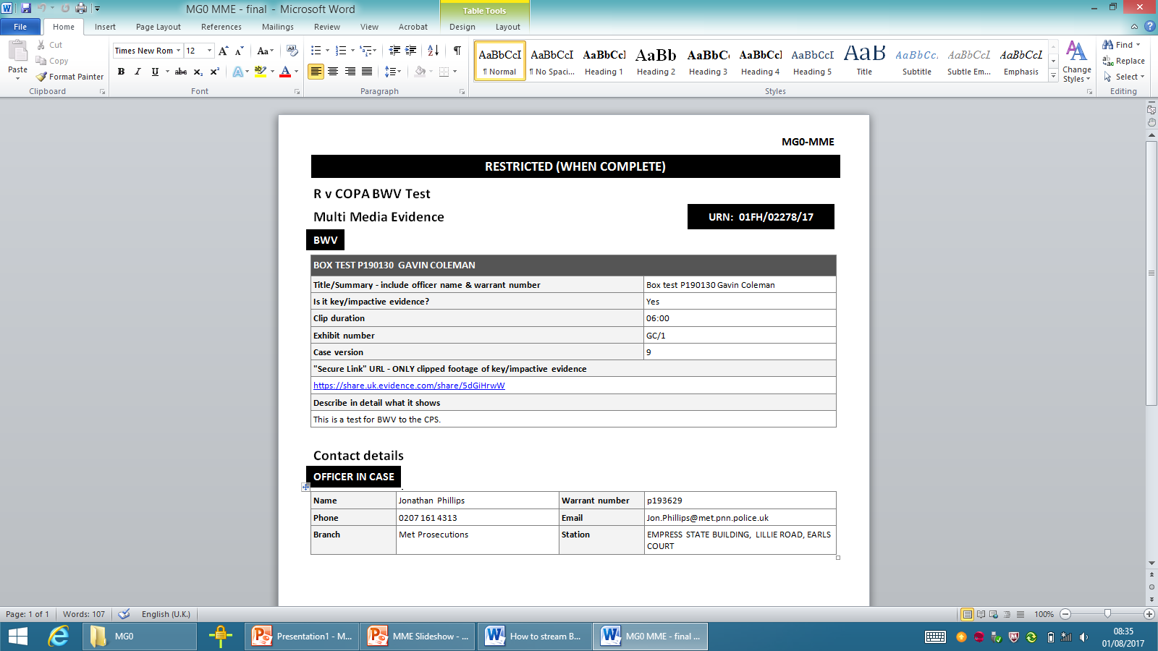
How to stream BWV footage
Footage can be streamed using PCU WiFi.
Footage cannot be streamed in a custody environment. If required in court, footage can be streamed to your client in the courtroom using PCU WiFi.
Open the document containing the BWV and go the URL link: -

Slide 10
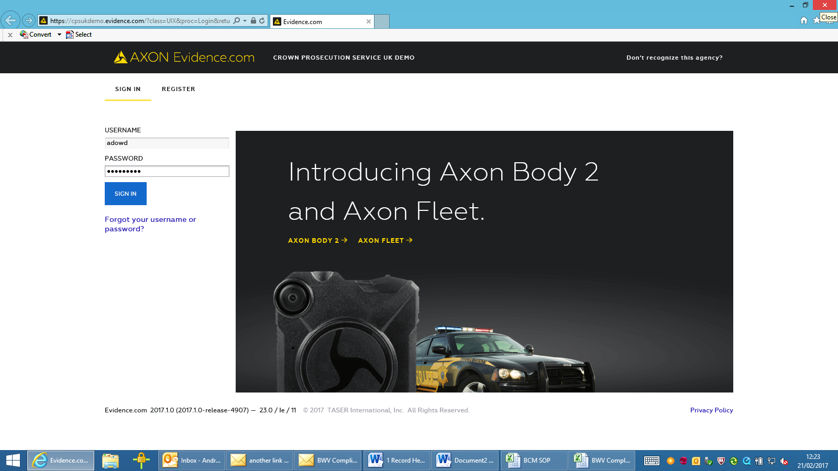
Click on the link and the Evidence.com sign-in screen will show. Enter your user name and password and click sign in: -

Slide 11
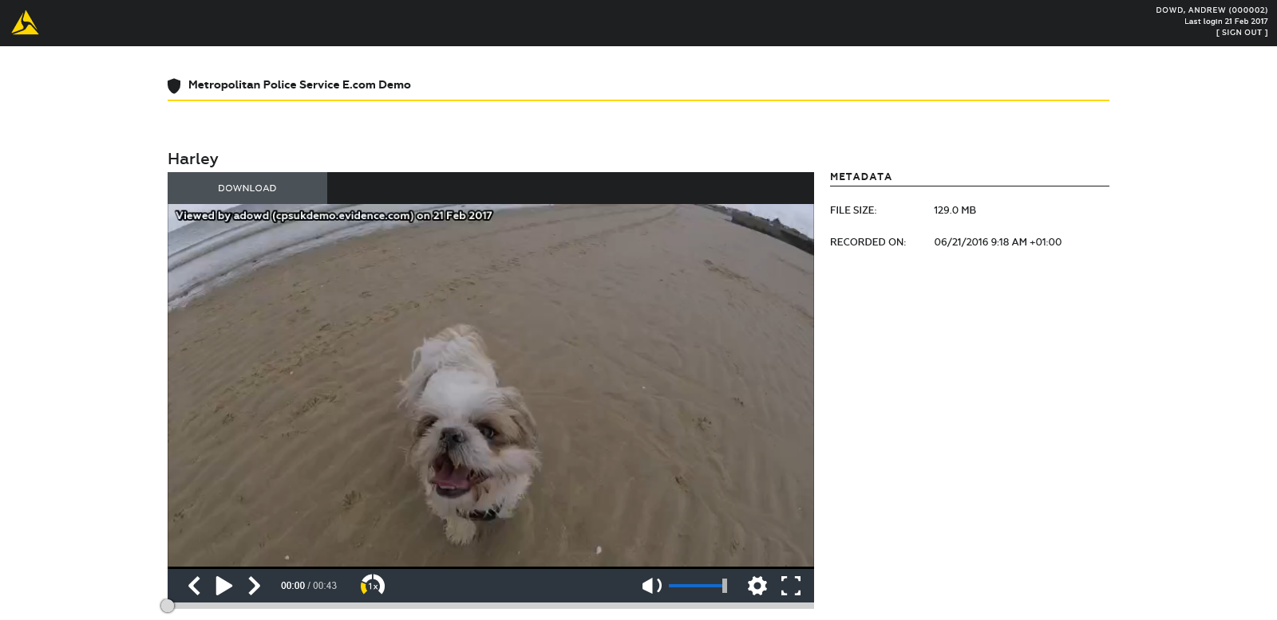
The footage will be displayed on screen. Press the play button at the bottom of the screen to play the footage: -

Slide 12
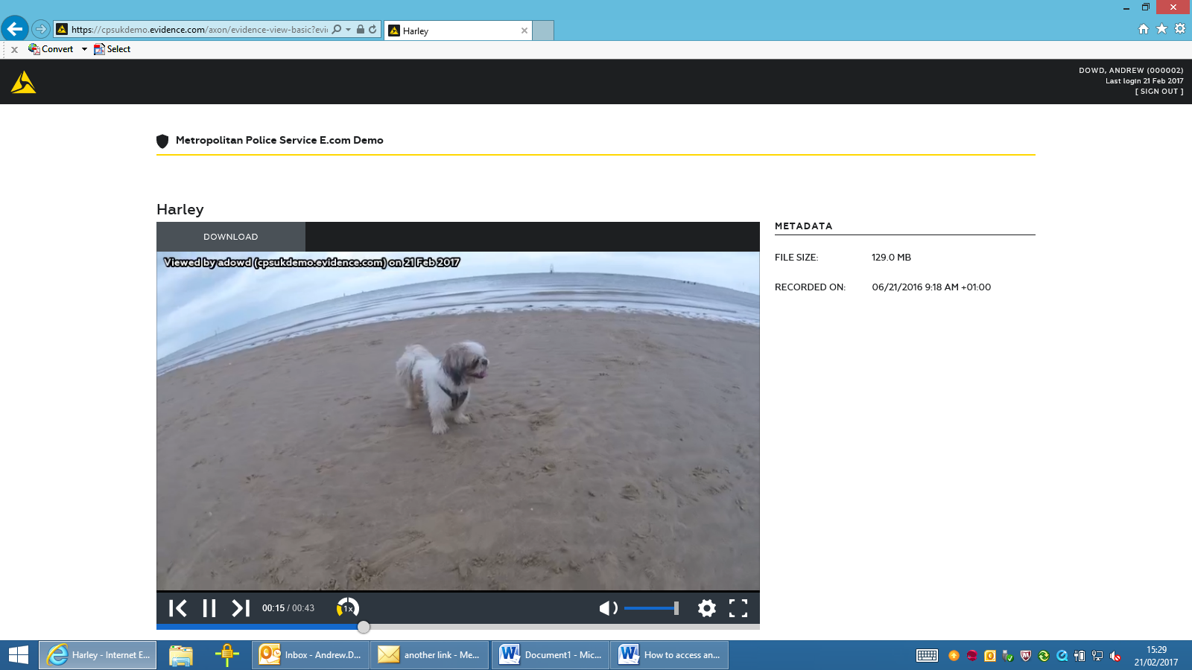
Footage can be paused by pressing the pause button, you can slide the bar at the bottom to move forward or backward, or you can click on the previous or next frame buttons to navigate: -
The time the footage was captured is given as UTC time.

Slide 13
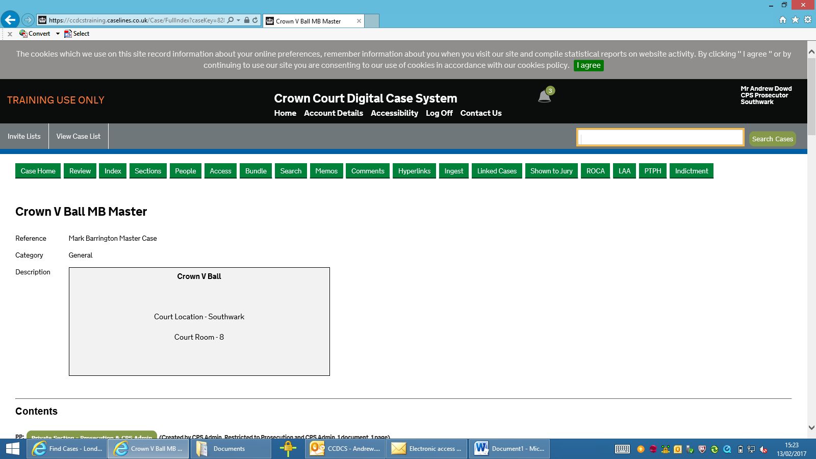
How to view BWV footage using the CCDCS
In the case containing the BWV, go to Index: -

Slide 14
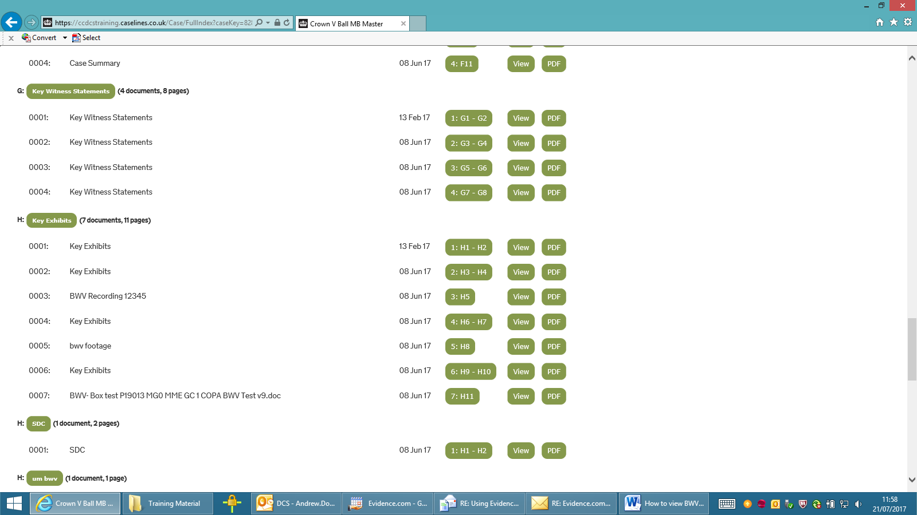
Go the Exhibits/Key Exhibits section. Locate the correct exhibit and click on the PDF radial button: -

Slide 15
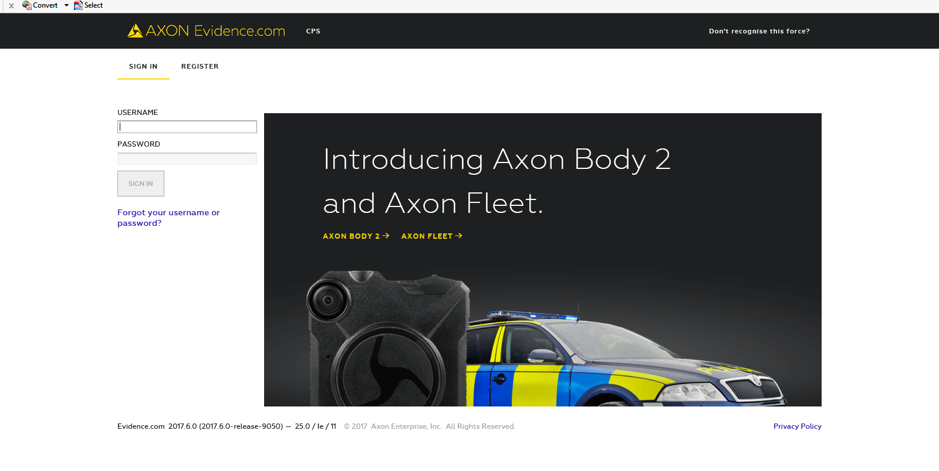
Click on ‘Open’ and the document will open on screen. Click on the hyperlink and then log in to Evidence.com:
Once signed in the footage will be streamed on screen.

